Slide 1


Automobile Dealership Management System
Project Group - 14
Presented by:
Joseph Joshi Aerrolla
PROFESSOR:
Ethan Gomes
MANUEL MONTROND
Ruturaj Avinash Pangavhane
Pengcheng Li
12-11-2024
1

Slide 2
⁠Overview And Key Aspects
The Automobile Dealership Management System is a comprehensive database solution designed to streamline operations and enhance customer satisfaction the competitive automobile dealership industry.
The primary objective of this project is to create an efficient database system to manage inventory, sales operations, customer relationships, and after-sales services, ensuring operational efficiency and improved decision-making.
The database covers all key dealership functions, including detailed vehicle management for both new and pre-owned cars, integration of dealer supplies and parts inventory, test drive scheduling, sales and financing processes, customer feedback tracking, and vehicle servicing.
The key purpose of this project is to provide a centralized and structured platform to manage dealership operations, reduce inefficiencies, and deliver a seamless customer experience.
2

Slide 3
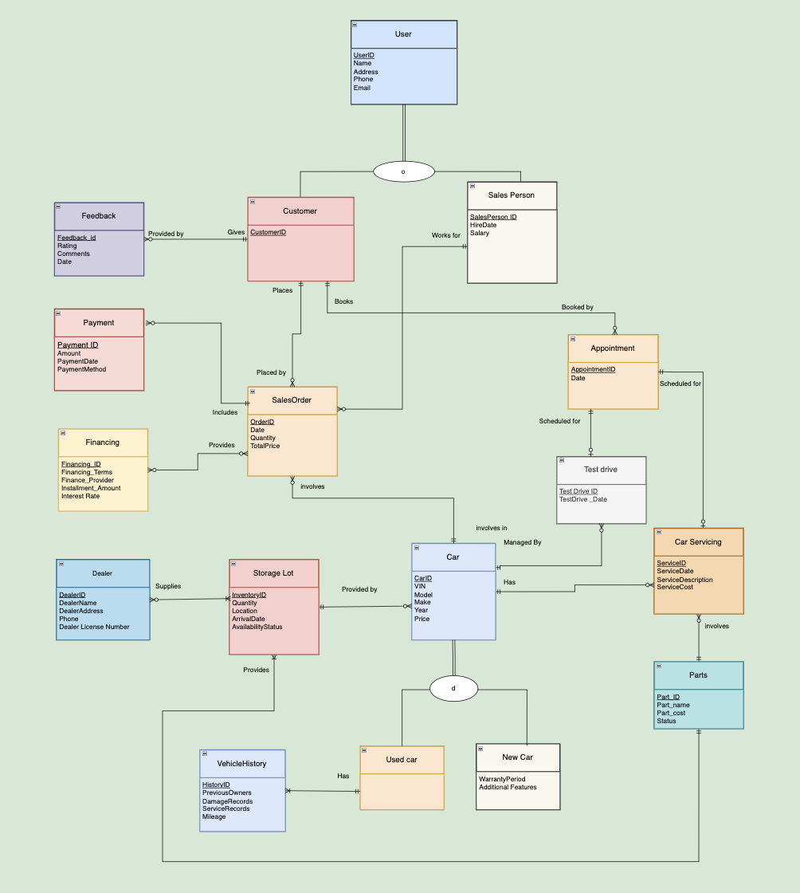
Entity Relationship Diagram
3

Slide 4
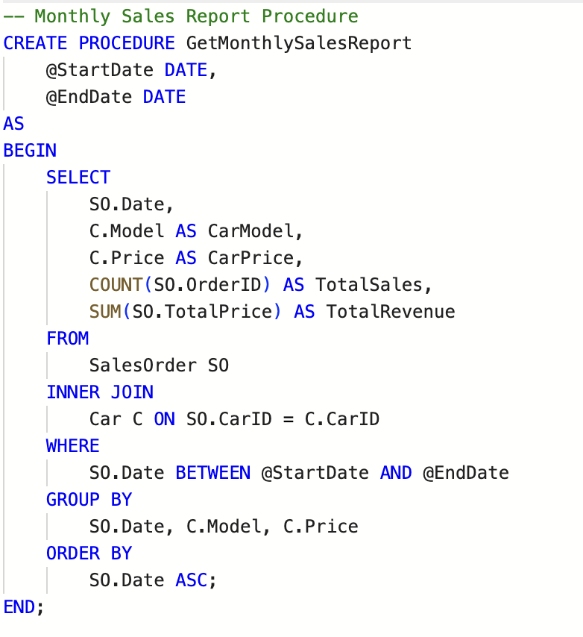
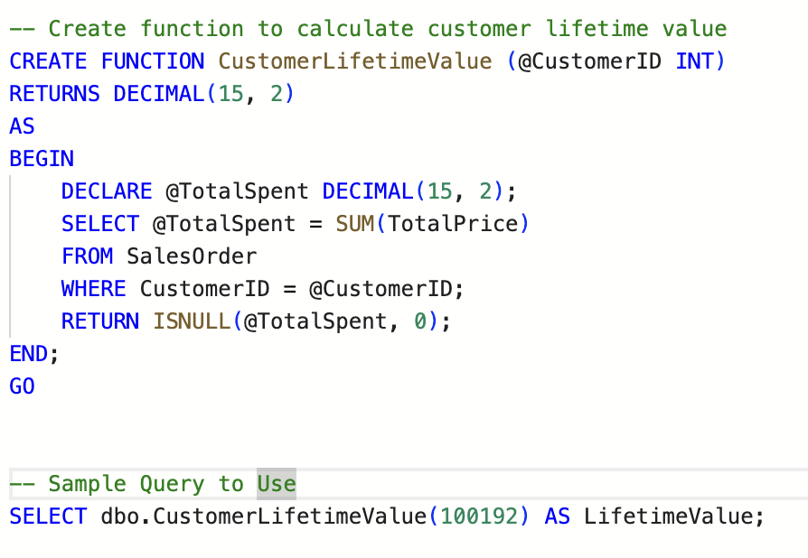
STORED PROCEDURES AND UDF
EXEC GetMonthlySalesReport @StartDate = '2024-01-01', @EndDate = '2024-01-31';
Aligns with the dealership's focus on sales performance and profitability.
Helps identify high-value customers for targeted marketing and personalized offers.
4

Slide 5
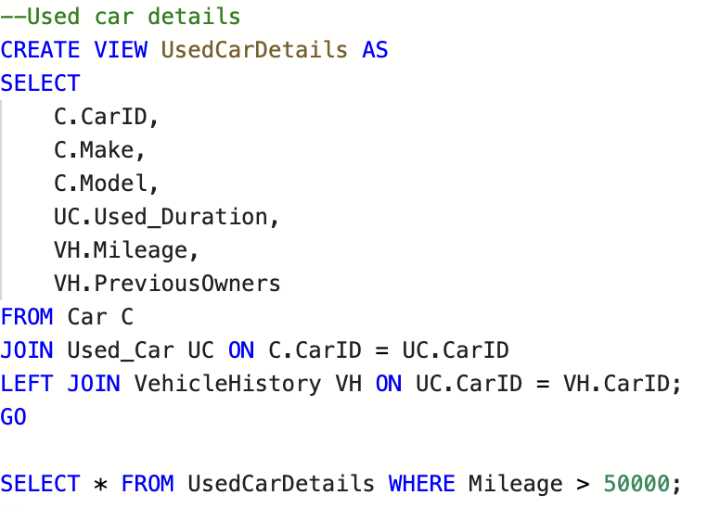
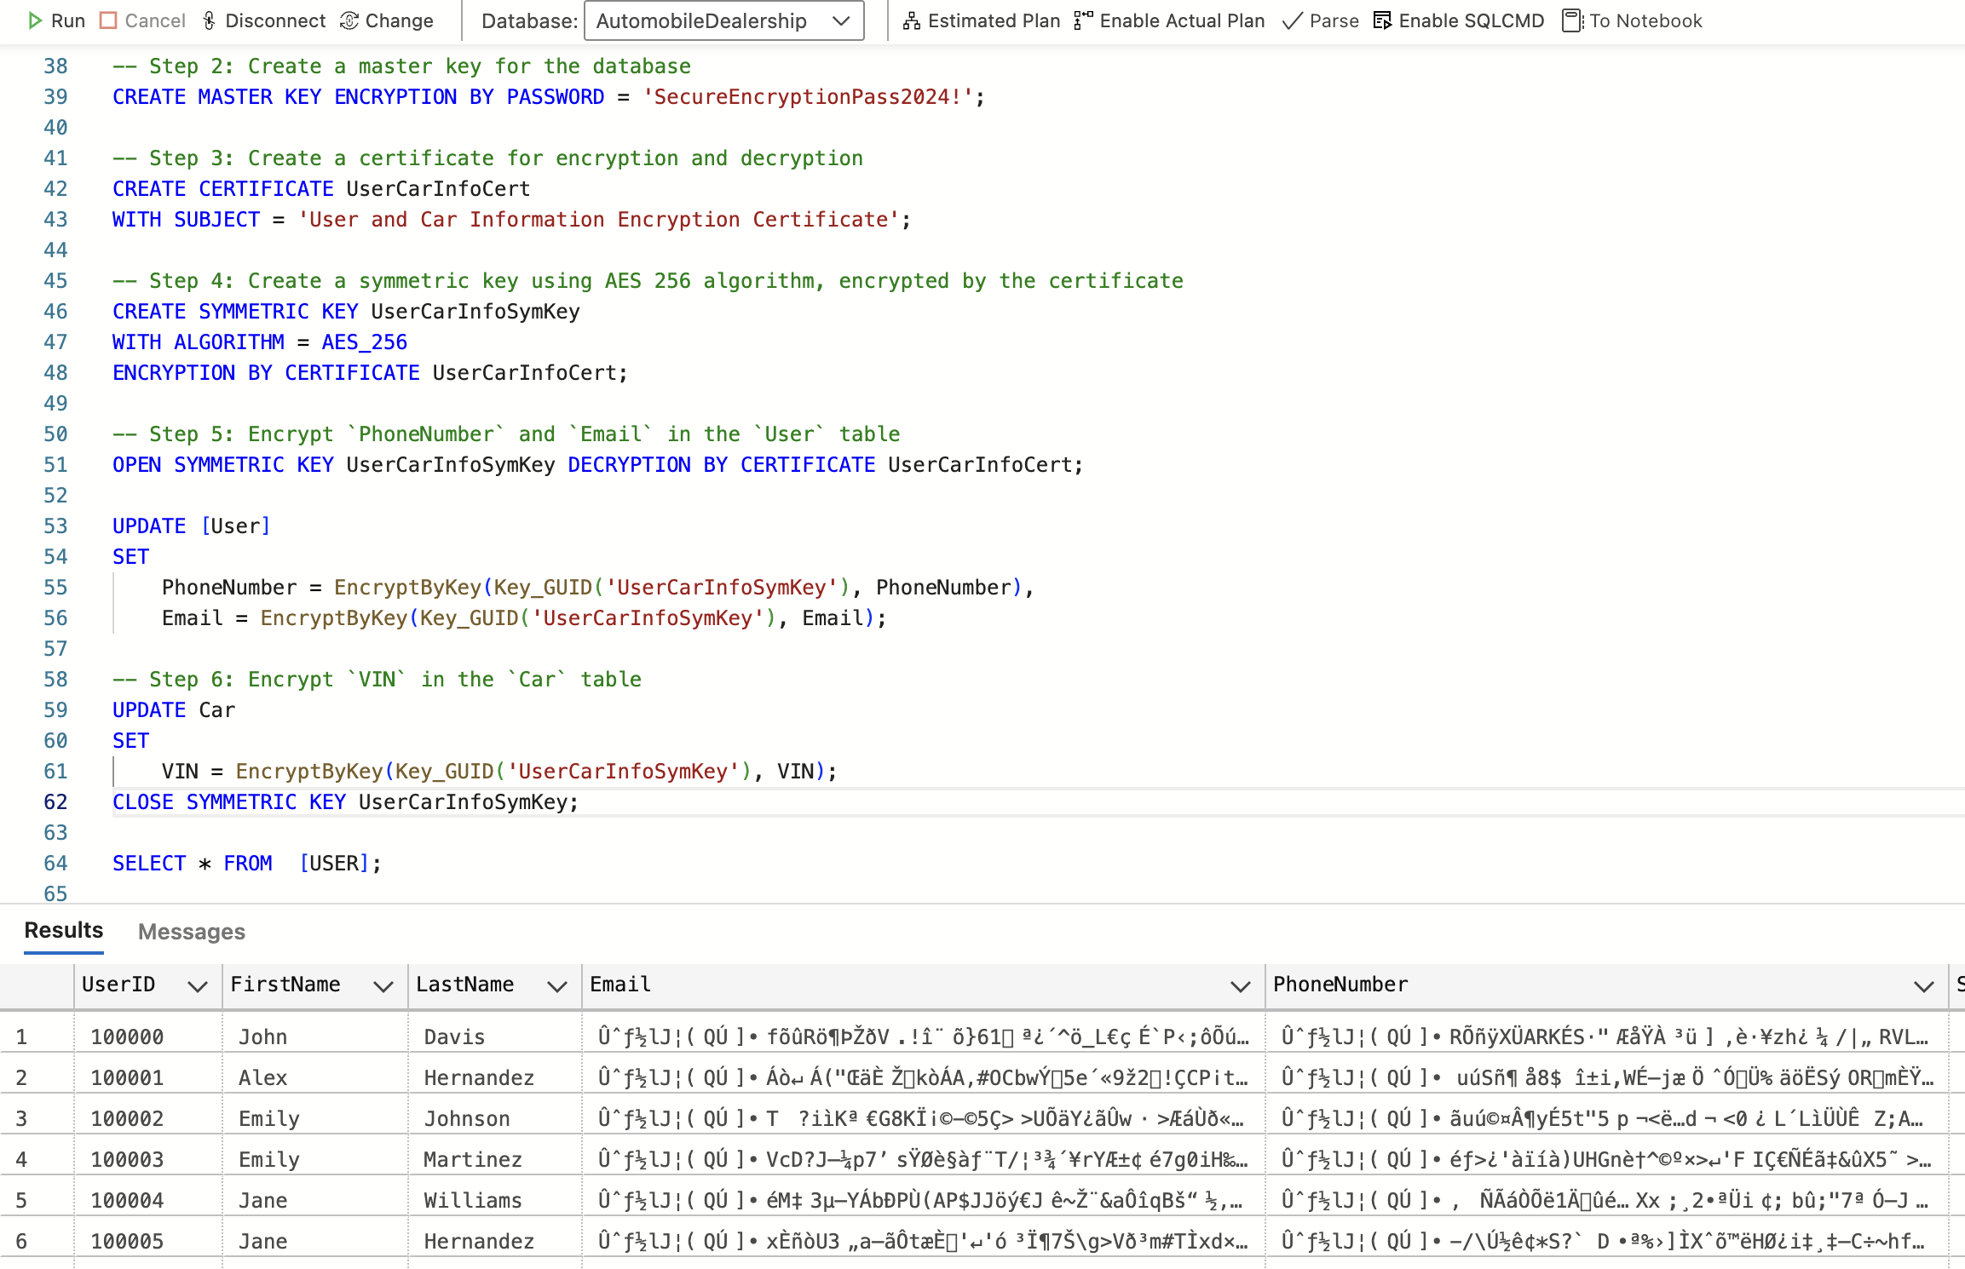
VIEWS AND ENCRYTION
Operational Use: Provides key metrics (e.g., mileage, previous owners) that are critical for pricing and sales of used cars.
Efficient Design: Uses joins effectively to aggregate data from related tables without redundancy.
Business Relevance: Supports dealership goals by enhancing transparency and aiding in decision-making regarding used vehicle inventory.
5

Slide 6
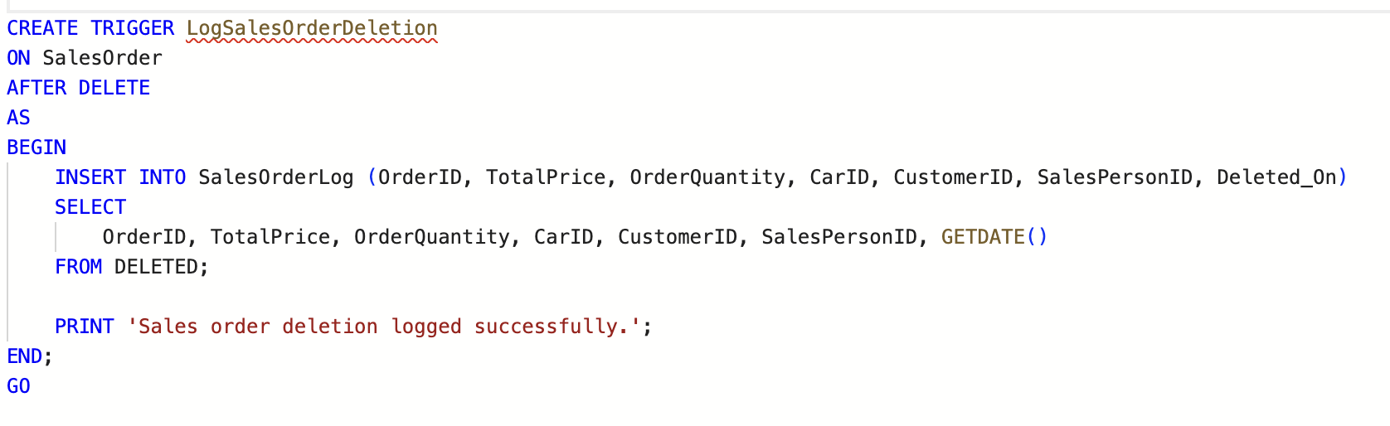
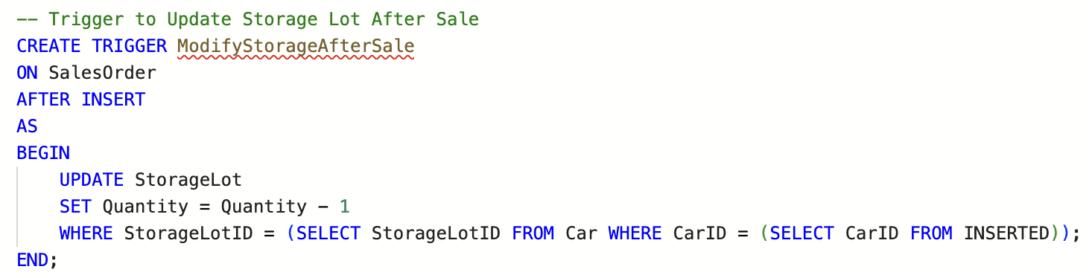
TRIGGERS
Data Auditing: Tracks deletions from the SalesOrder table, ensuring accountability and data integrity.
Compliance and Security: Provides a log of deleted records, which is often required for audit trails in financial or operational systems.
Clarity: The trigger logic is simple, focused, and outputs a message for confirmation.
Scalability: Can be easily extended to include additional details or integrate with external logging systems.
Accurate inventory management directly impacts business operations, preventing issues like overselling or incorrect stock reporting. This trigger aligns with the core operational needs of an automobile dealership.
6

Slide 7
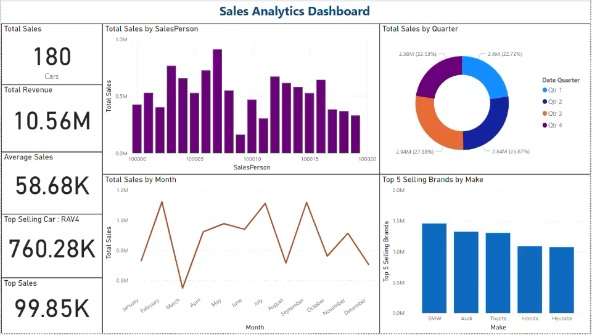
VISUALIZATION
7

Slide 8
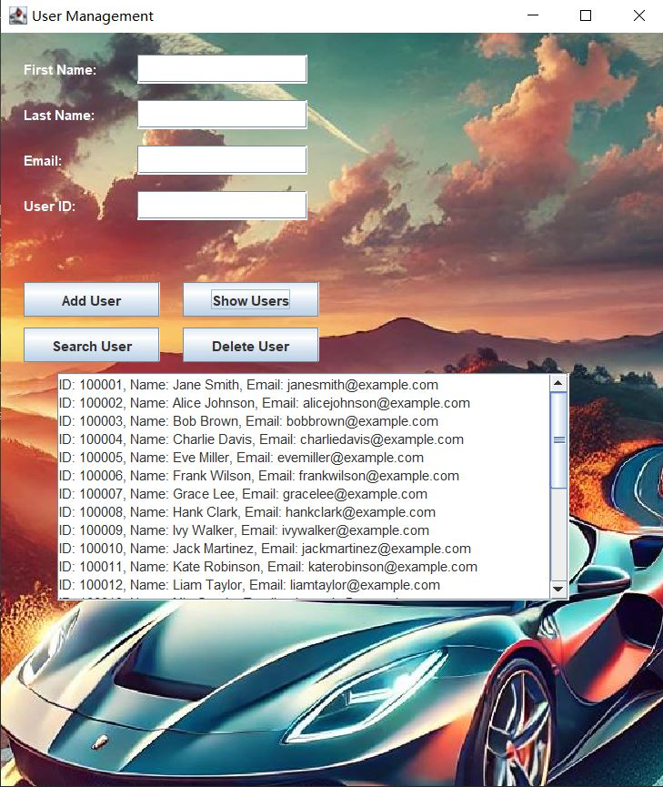
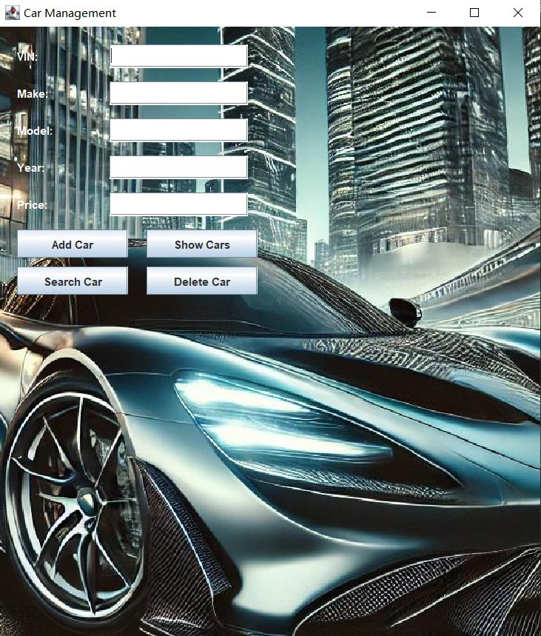
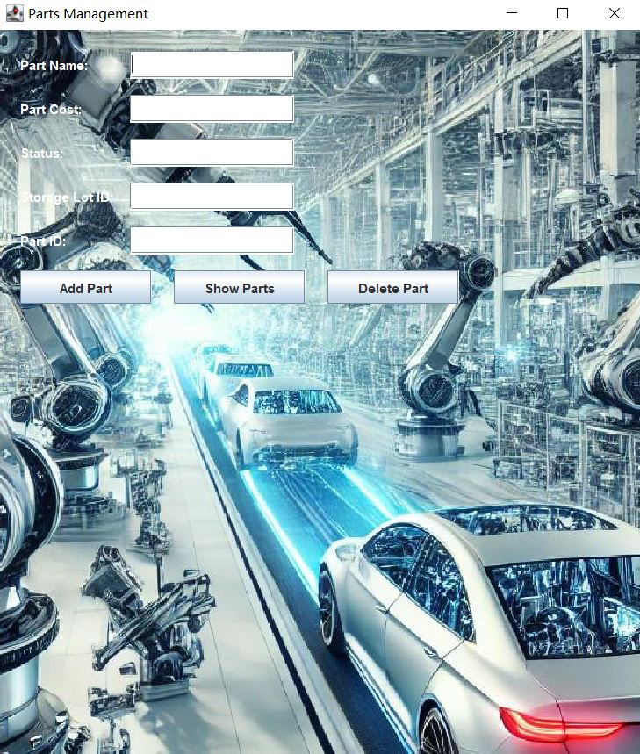
GRAPHICAL USER INTERFACE (GUI)
8

